Slide 1
Midterm presentation
~Team 1

Slide 2
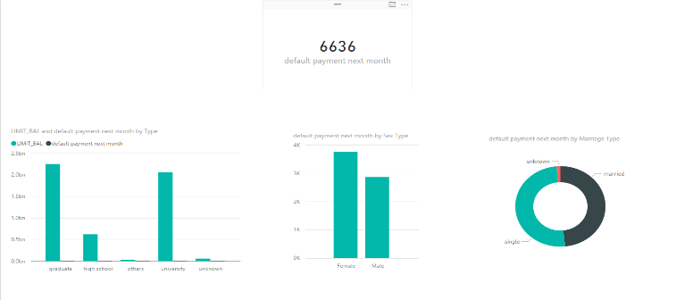
Question 1- Credit Card Default
Data Exploration

Slide 3
Data Cleansing
The headers (X1, X2, X3…) are replaced with the actual meaningful headings
Unknown values in Education(0, 5, 6) and marriage(0,3) were dealt with.
All the values in “Education” and “Marriage” which contain NAN are replaced with mean of their respective columns
Three new features have been added to the dataset called “Total Bill”, “Total Paid”, “Avg_Status”.

Slide 4
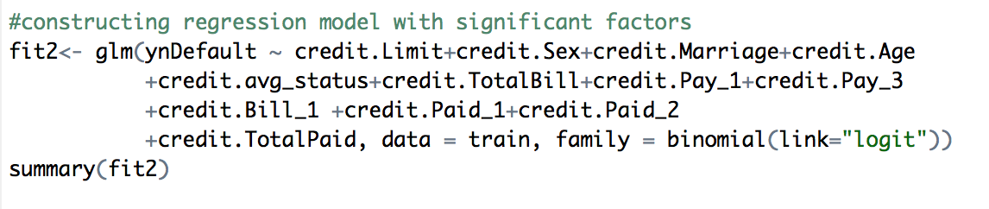
Logistic Regression

Slide 5
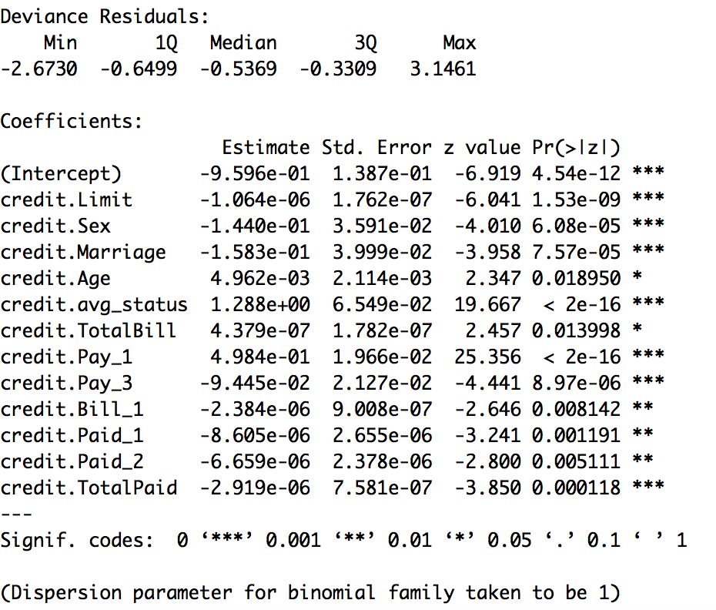

Slide 6
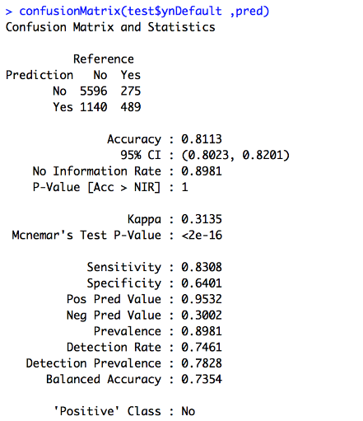
Classification Matrix

Slide 7
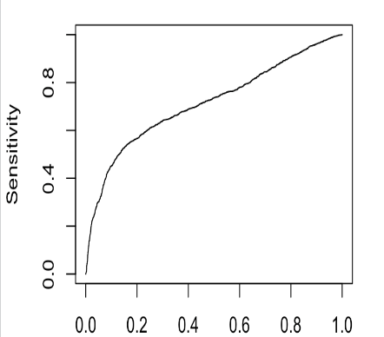
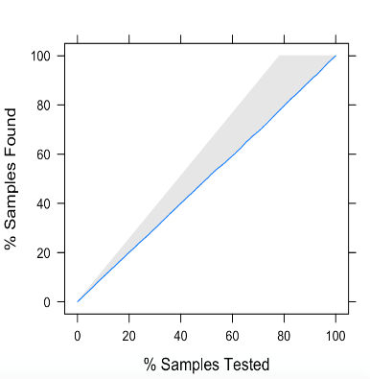
ROC curve / Lift chart

Slide 8
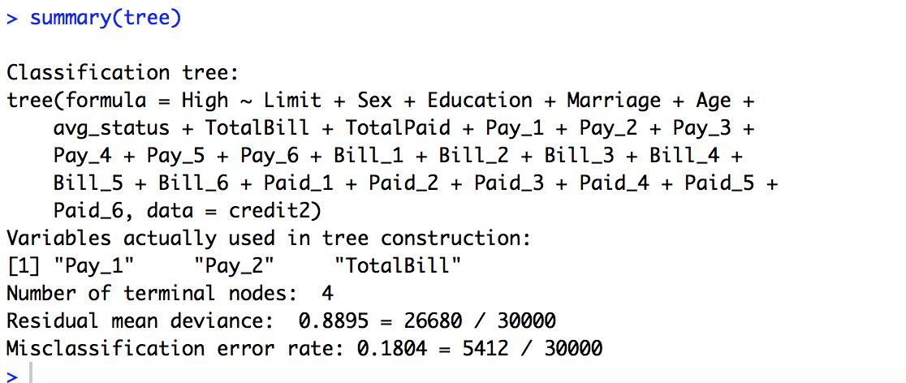
Classification Tree

Slide 9
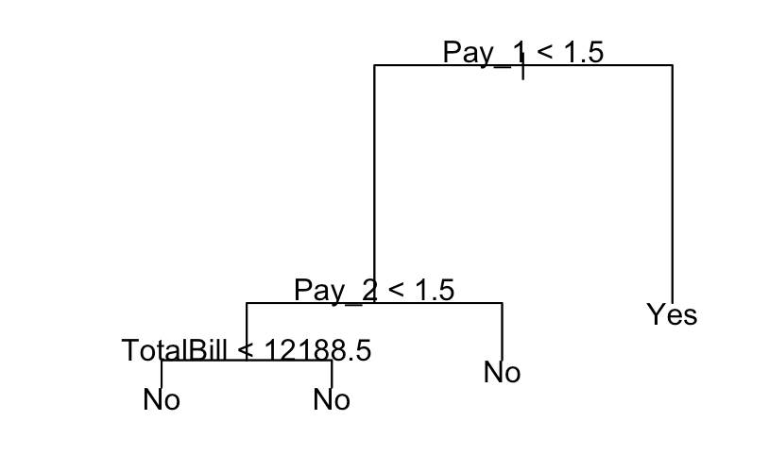
Tree

Slide 10
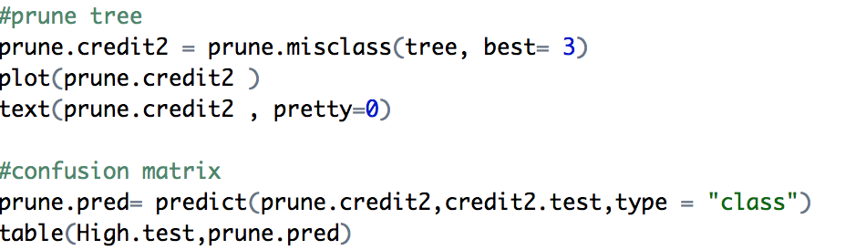
Pruning the Tree

Slide 11
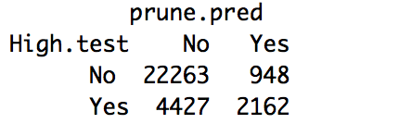
Confusion Matrix

Slide 12
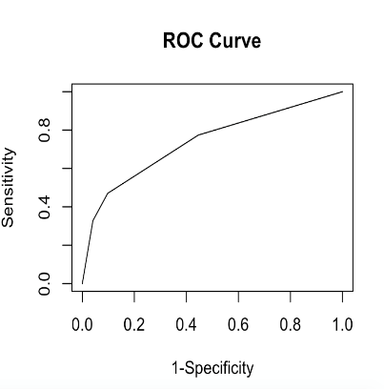
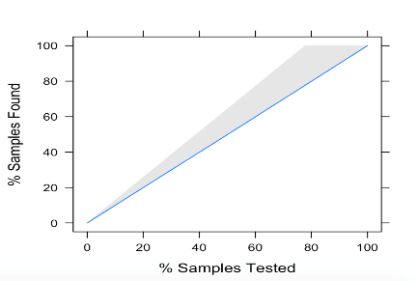
ROC/ Lift chart

Slide 13
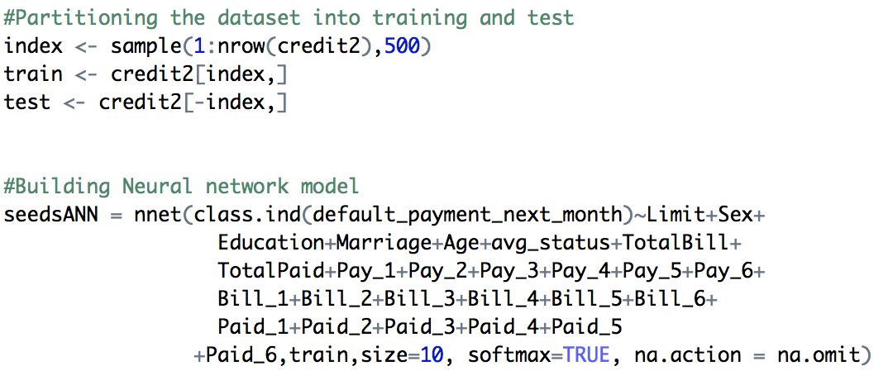
Neural Network

Slide 14
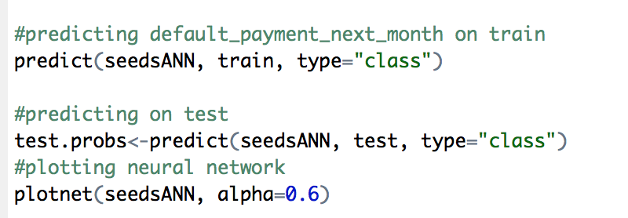
Prediction

Slide 15
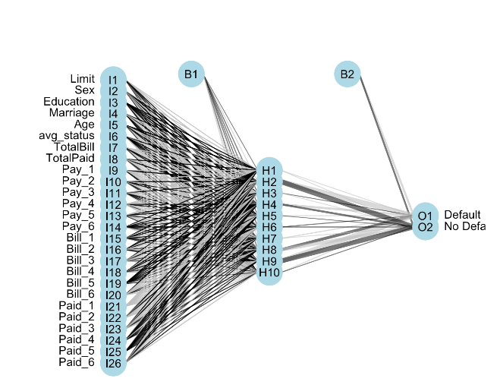
Network

Slide 16
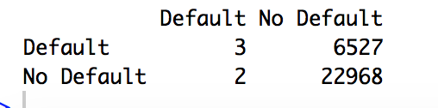
Confusion Matrix

Slide 17
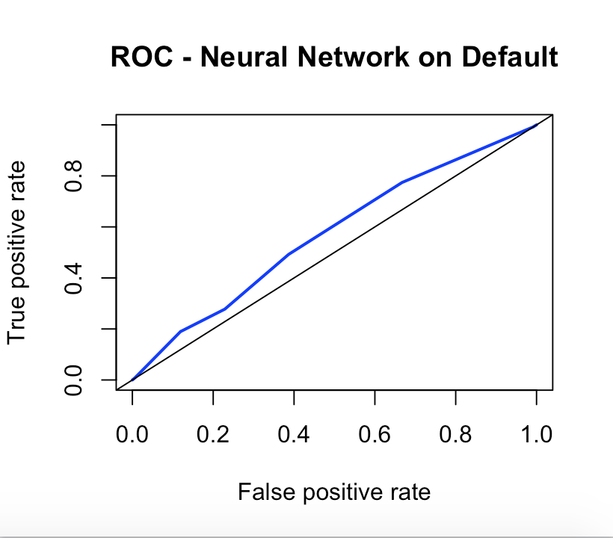
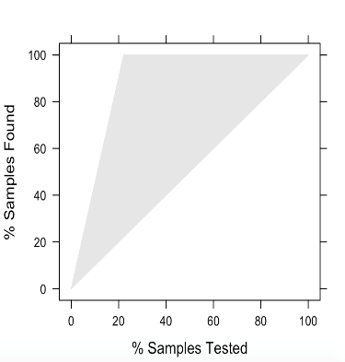
ROC/ Lift Chart

Slide 18
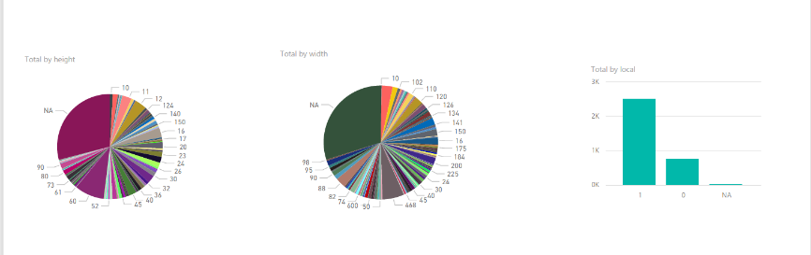
Question 2- AD Classification

Slide 19
Data Cleansing
The file containing header is made into the column headers for the second file containing the data
The 3 continuous columns of “height”, ”weight” and “ratio” contains “?” which are replaced by NA
Using a library called “Hmisc” and a function called aregImpute{Hmisc}.
This function calculates and predicts values for the NA values from a full Bayesian predictive distribution.
The function provides five values for each NA value.
Then median is calculated of the five values to substitute the NA value.

Slide 20
Data Cleansing
There are 1559 features that are present. Therefore, using non zero variance to select columns, which have 95%-5% ratio of most commonly used values. This is done to reduce the number of columns in the dataset.
On running non- zero variance function on the dataset we are left with 22 columns.

Slide 21
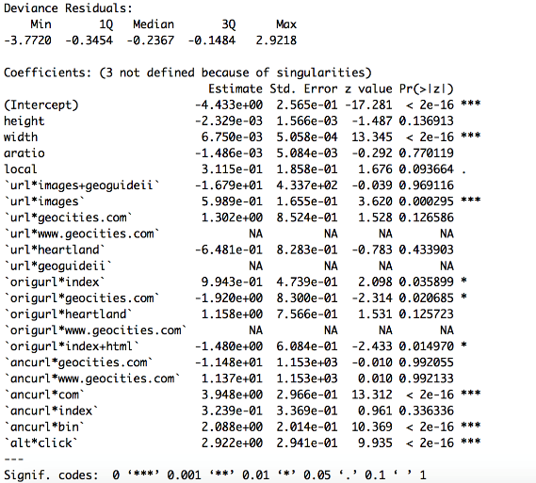
Logistic Regression

Slide 22
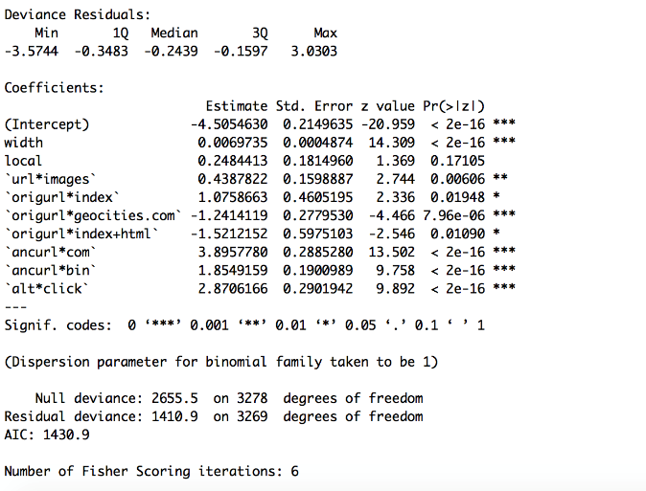
On selecting appropriate features

Slide 23
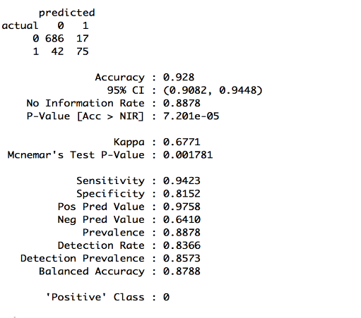
Confusion Matrix

Slide 24
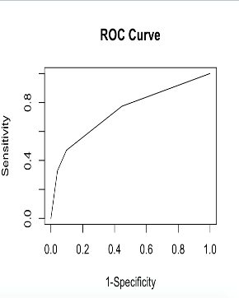
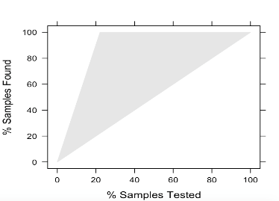
ROC/ Lift Chart

Slide 25
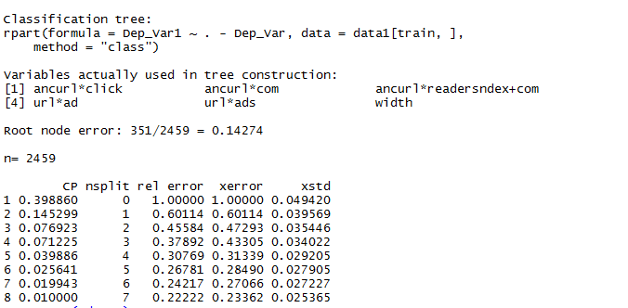
Classification Tree

Slide 26
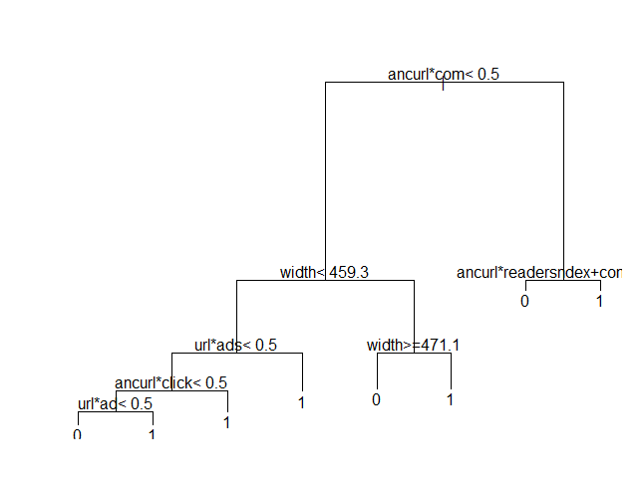
Tree

Slide 27

Confusion Matrix

Slide 28
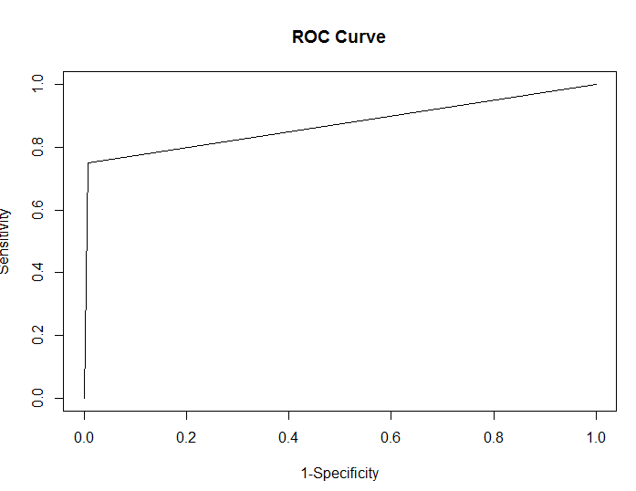
ROC curve

Slide 29
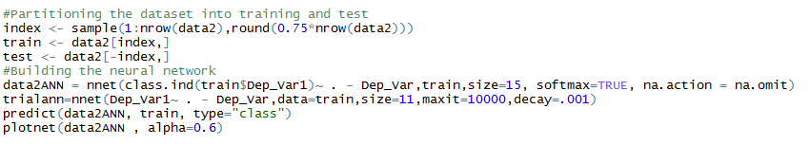
Neural Network

Slide 30
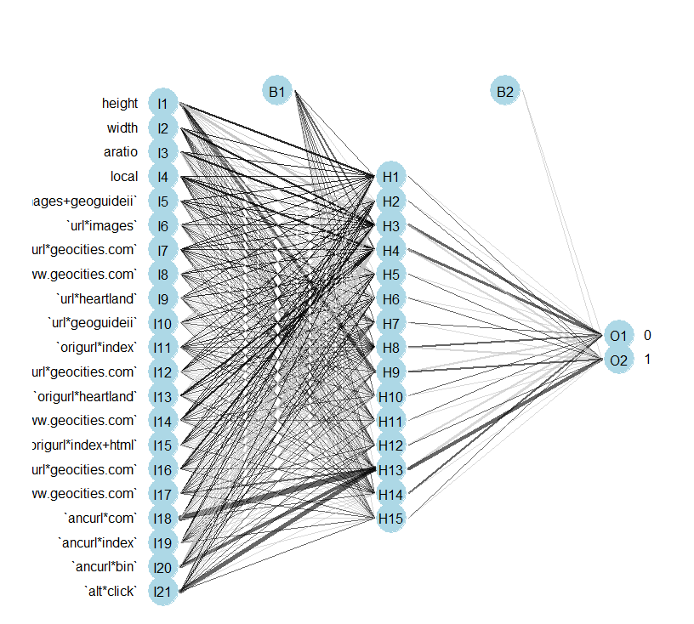
Plotting Neural Network

Slide 31
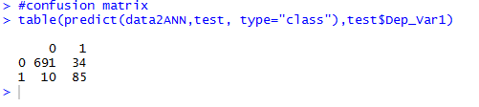
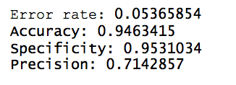
Confusion Matrix

Slide 32
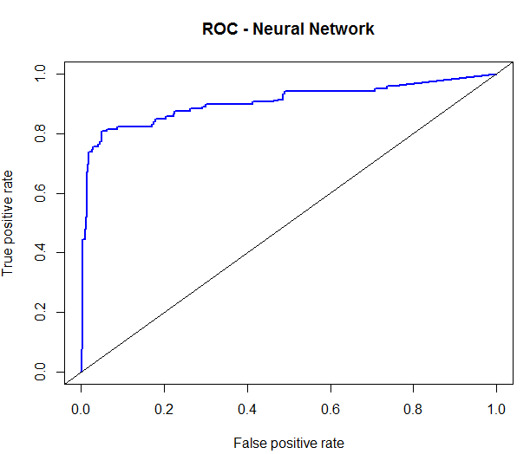
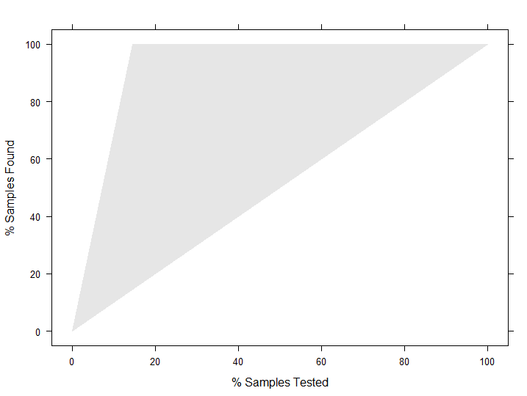
ROC/ LIFT chart

Slide 33
Problem 3
Predicting hourly power generation up to 48 hours ahead at 7 wind farms

Slide 34
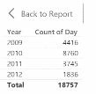
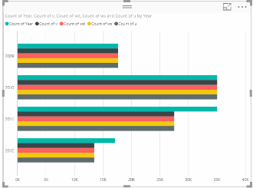

Power BI Observations
WindFarm data observation
Train.csv observation
Benchmark.csv

Slide 35
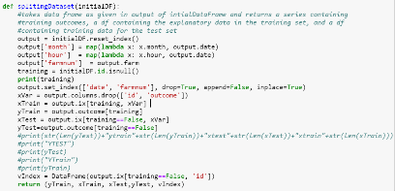
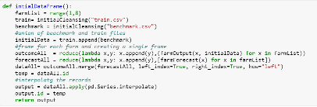
Dataset preparation
Preparing Dataset
Spliting datset

Slide 36
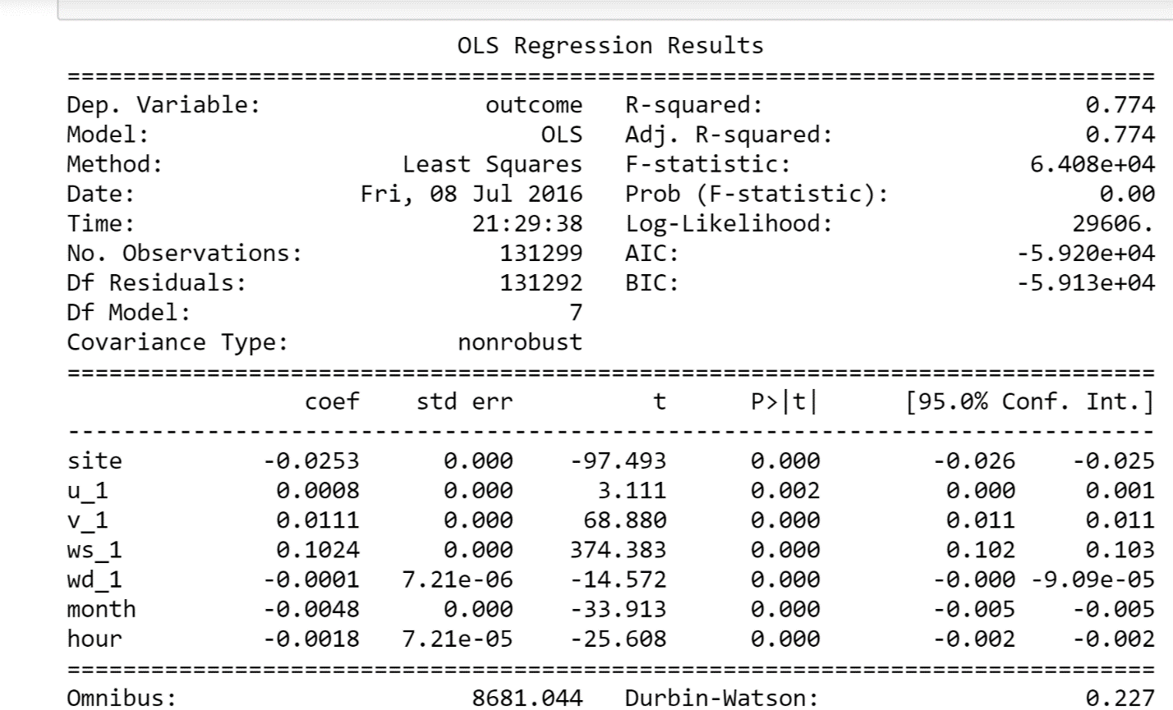
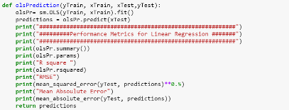
Linear Regression model creation and Prediction
Performance metrics

Slide 37
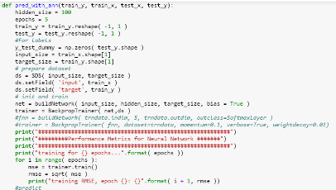
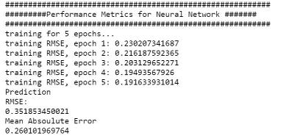
Neural Network
Model Creation and prediction
Performance Metrics

Slide 38
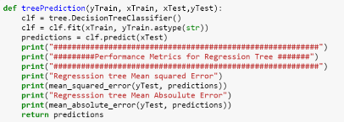

Regression Tree
Model creation and prediction
Performance Metrics

